Slide 1

Dr. Manju Khurana
Assistant Professor, CSED
TIET, Patiala
manju.khurana@thapar.edu

Slide 2
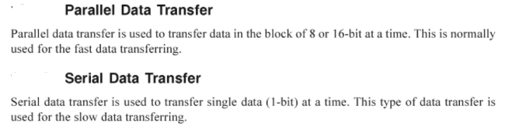
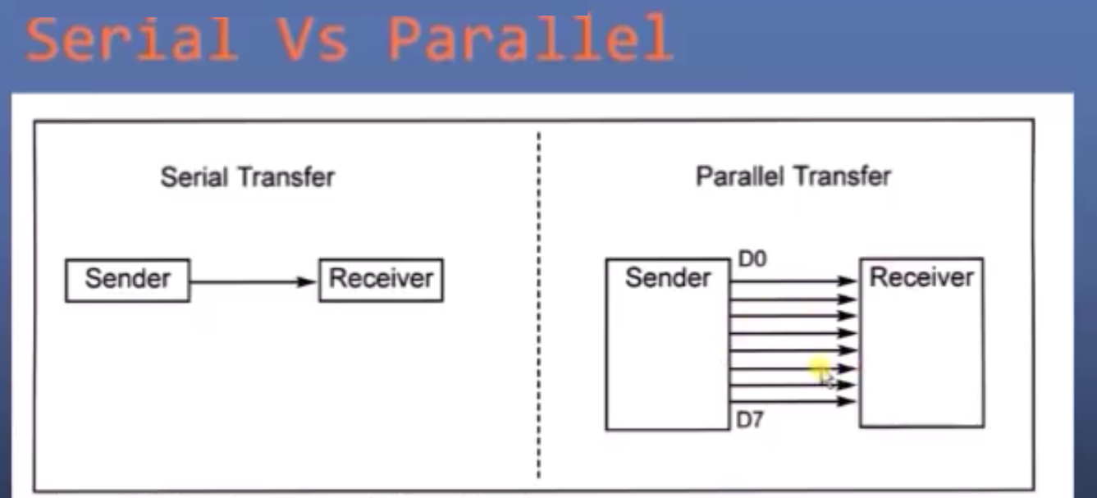
Methods of Communication

Slide 3
Serial/Parallel
Serial data transfer | Parallel data transfer
1. 1 bit of data is transferred at a time. | 1. 8/16 bits of data is transferred at a time.
2. Two lines are required to be connected. (one for data transfer and one to provide ground). | 2. 9/17 lines are required to be connected. (8/16 bits for data transfer and one for ground).
3. Slow data transfer. | 3. Fast data transfer.
4. Used for long distance communication. | 4. Used for Short distance communication.

Slide 4
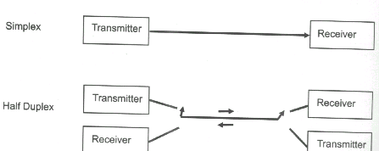
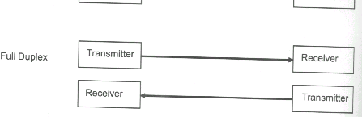
Types of Transmission

Slide 5
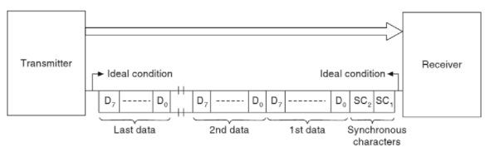
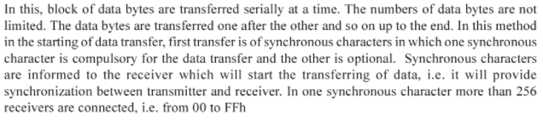
Formats of Serial Data Transfer
Synchronous Serial Data Transfer

Slide 6
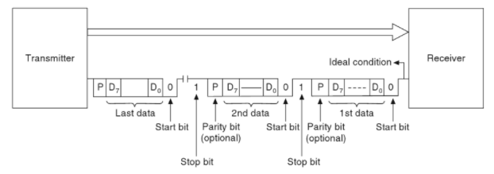
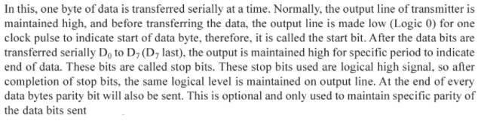
Formats of Serial Data Transfer
Asynchronous Serial Data Transfer

Slide 7
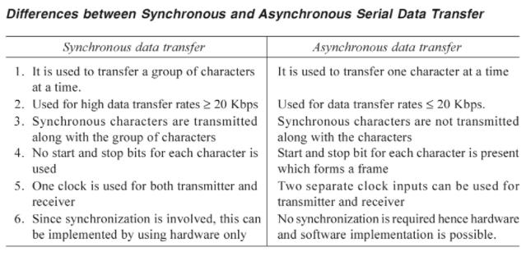

Slide 8
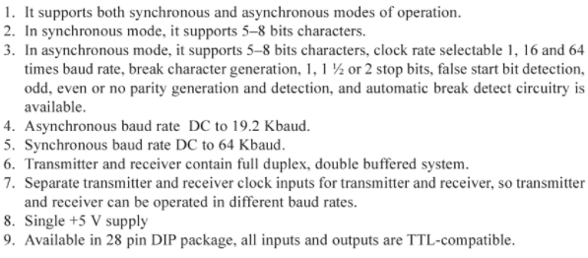
Features of 8251

Slide 9
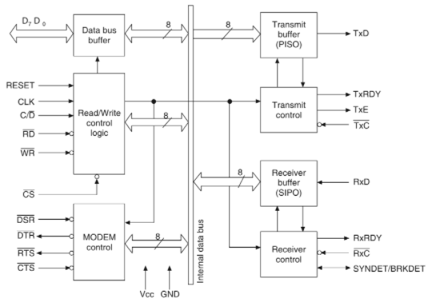
# Block diagram of the 8251 USART

Slide 10
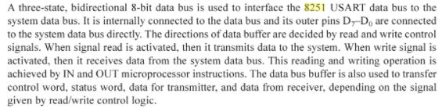
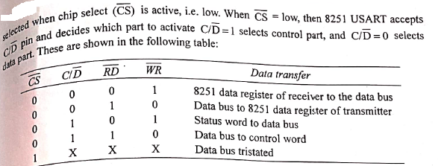
Data Bus Buffer
Read/Write Control Logic

Slide 11
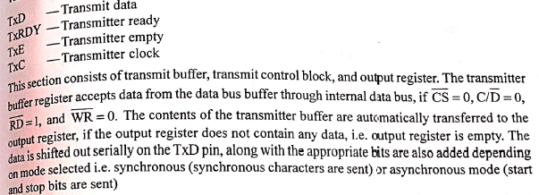
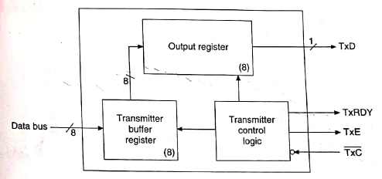
Transmitter Section

Slide 12

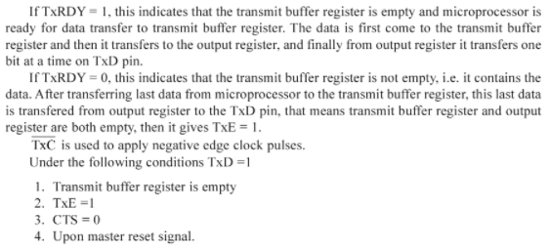
Transmitter Section

Slide 13
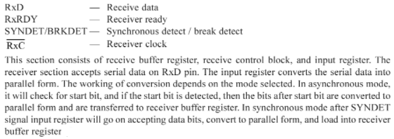
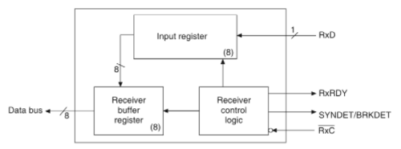
Receiver Section

Slide 14
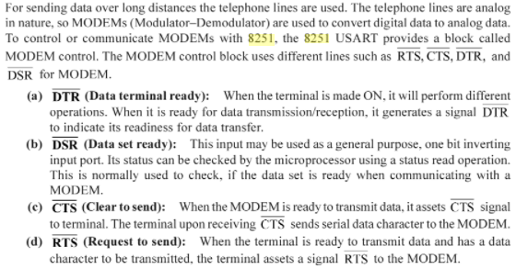
MODEM Control

Slide 15


